Slide 1

Driving Inclusive Open Finance -
The DPI Approach
13 June, 2024
Kamya Chandra
Chief Strategy Officer, Centre for DPI
kamya@cdpi.dev

Slide 2

Open Finance is both for
Payments… …and Data Sharing
Last mile population should be able to use this infra to create a digital footprint
All kinds of financial data should be seamlessly sharable, for access to many services

Slide 3




Digital payments grows organically, but
in silos
Bank A
Mobile Money/ Wallet B
Card Network C
App/
NetBanking payment
App payment
Card payment
Every new payment method ends up building their own closed network fragmenting the ecosystem
Notes:
Digital penetration is a reality, as is mobile money/fintech/wallet penetration

Slide 4


Digitisation of low value, high volume payments, usually cash based, can only scale via Neobank/fintech/mobile money innovation
Fintech & mobile money players drive last mile customer acquisition and diverse user experiences
But they are outside the formal banking system!

Slide 5



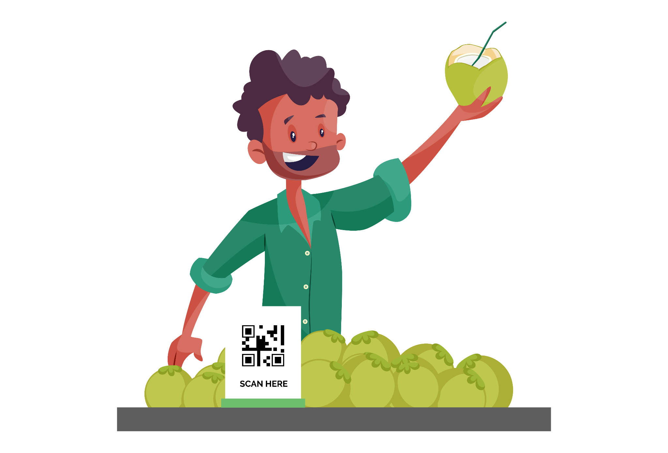

Regulators
Unbundle the flow of money from experience of money
Switch Operator
Banks
Manage Money
Fintechs
Users
Allow fintechs/wallets to innovate on UX without managing money
Allow banks to buy shares in a tech implementation entity to operate an innovative switch
User interface
Manage money
Build & Operate Rails
Govern & set rules/standards

Slide 6
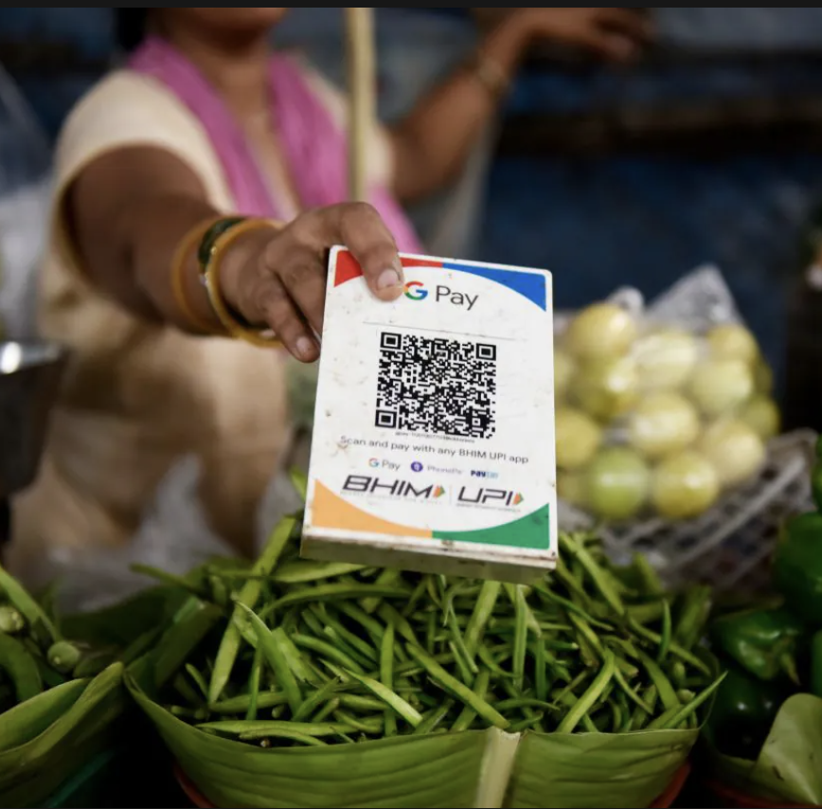



Inclusion through Interoperability on steroids across:
Any Account used for payment
Bank/Wallet/Mobile Money/Credit Lines!
Any App used to pay
Bank/Wallet/Mobile Money/Fintech
Any Device or channel
Feature phones, PoS machines, Smartphones, QR stickers; Online/Offline, Dynamic QR…
Any Recipient of payment
P2P, P2M, P2G, G2P etc.

Slide 7
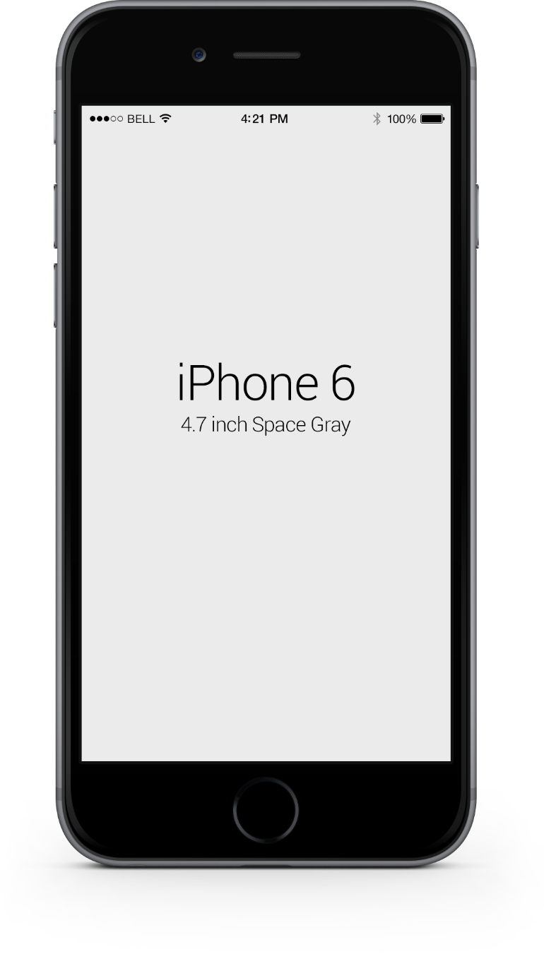
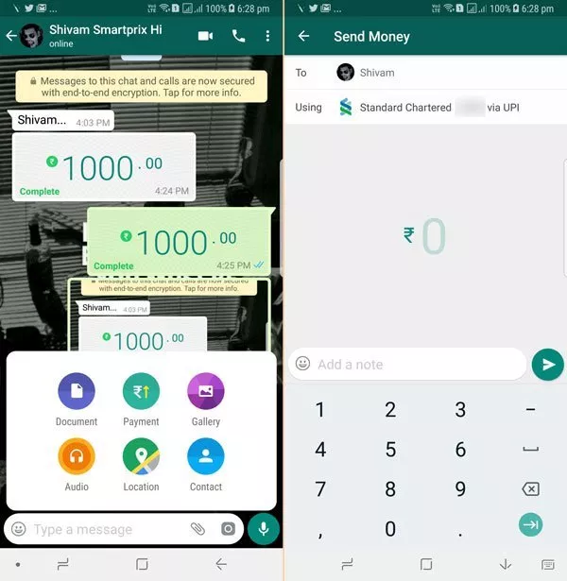
There should be no single way to use open banking payments rails!
“Alexa, pay…”
Feature phones & IVR
Dynamic & Static QR
IPO Subscription
Recurring payments
Credit cards & lines
Vouchers & benefits
Collect reauests

Slide 8
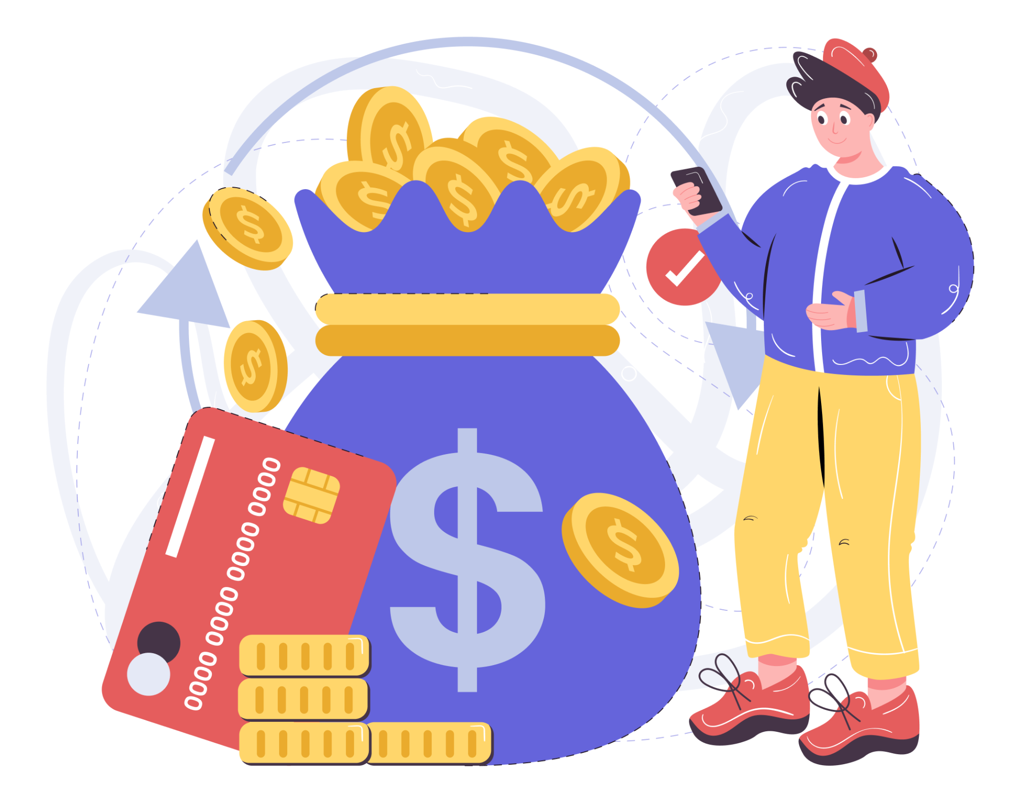
Increase
in deposits
with banks
Interoperable payments have powerful second order effects towards
economic growth!
People become data-rich with granular txn data!
Formalises
merchants & consumers
Commerce
grows
Increased economic activity & investment
Abundant granular data
available
Increased access to lending

Slide 9
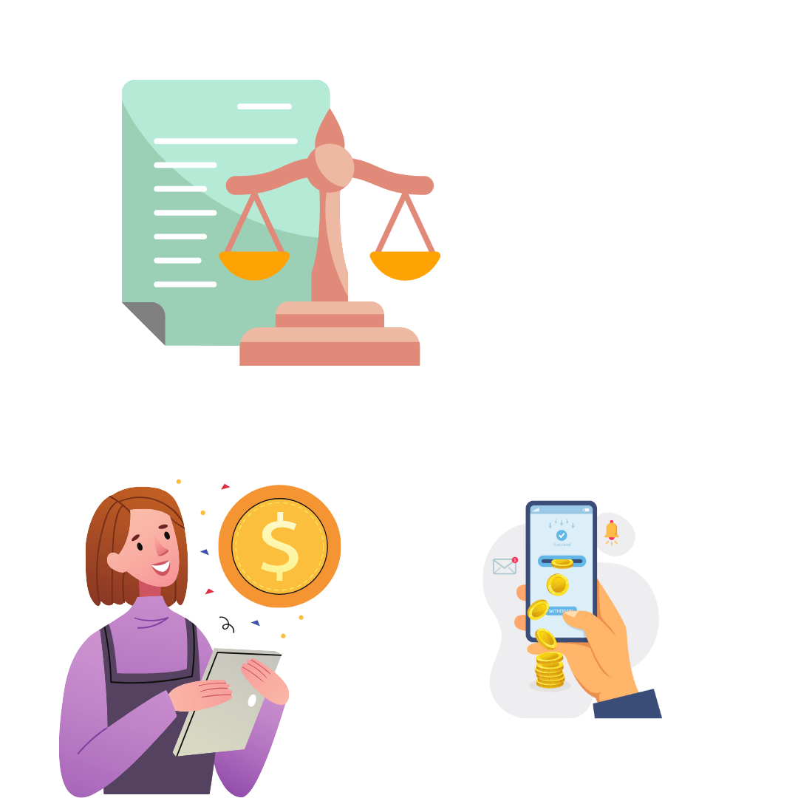
Regulators and Users have fundamentally different
reasons to participate in Open Finance for data!
Want to be in control of their data, Use (newly granular!) data to get access to services
Enforce data governance & privacy laws, Unlock market competition & innovation

Slide 10

The needs of the user should be the key design principles of Open Finance architecture!
Inclusive. Low cost. Unification across accounts

Slide 11






Any data across sectors should be able to plug into the network to receive/ share information with consent of the data owner
Financial Information Providers
Financial Information Users
Bank, Mo-Mo
Flow-Based Credit
Mutual Fund House
Personal Finance Management
Insurance Provider
Wealth Management
Tax Platforms
Robo Advisors
Data, consent requests
and responses

Slide 12

This can create a unified Personal Balance Sheet for Billions
with a richer Digital Footprint in a high-trust, low-cost fashion
MSMEs can use data sources indicating specific cash flow data
to allow banks to approve small ticket loans without requiring larger physical collateral.
Insurance Policies
Tax Returns
Investments
Credit History & Repayment Behaviour
Bank Statements, Savings, FDs, RDs

Slide 13
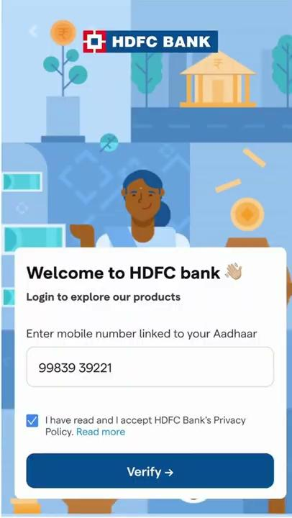
Small businesses all over the world struggle to access credit.
Here’s one of many Open Finance flows that make it seamless.
Business loan application
Individual - Personal loan application

Slide 14
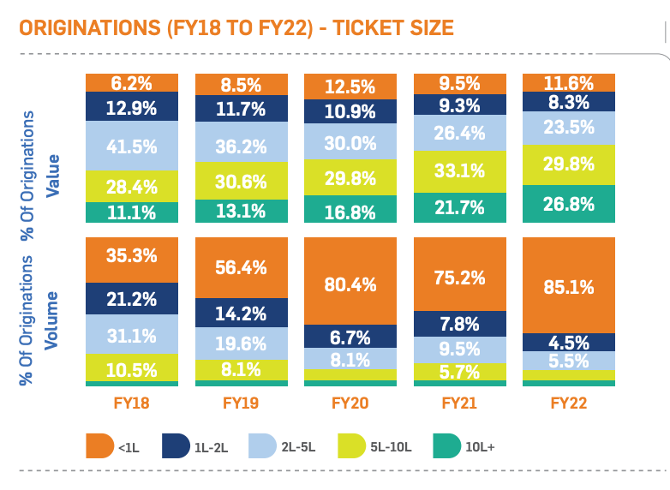
Small ticket credit in India has been growing already!
Likely based on granular data availability using payments rails & open finance data sharing!

Slide 15

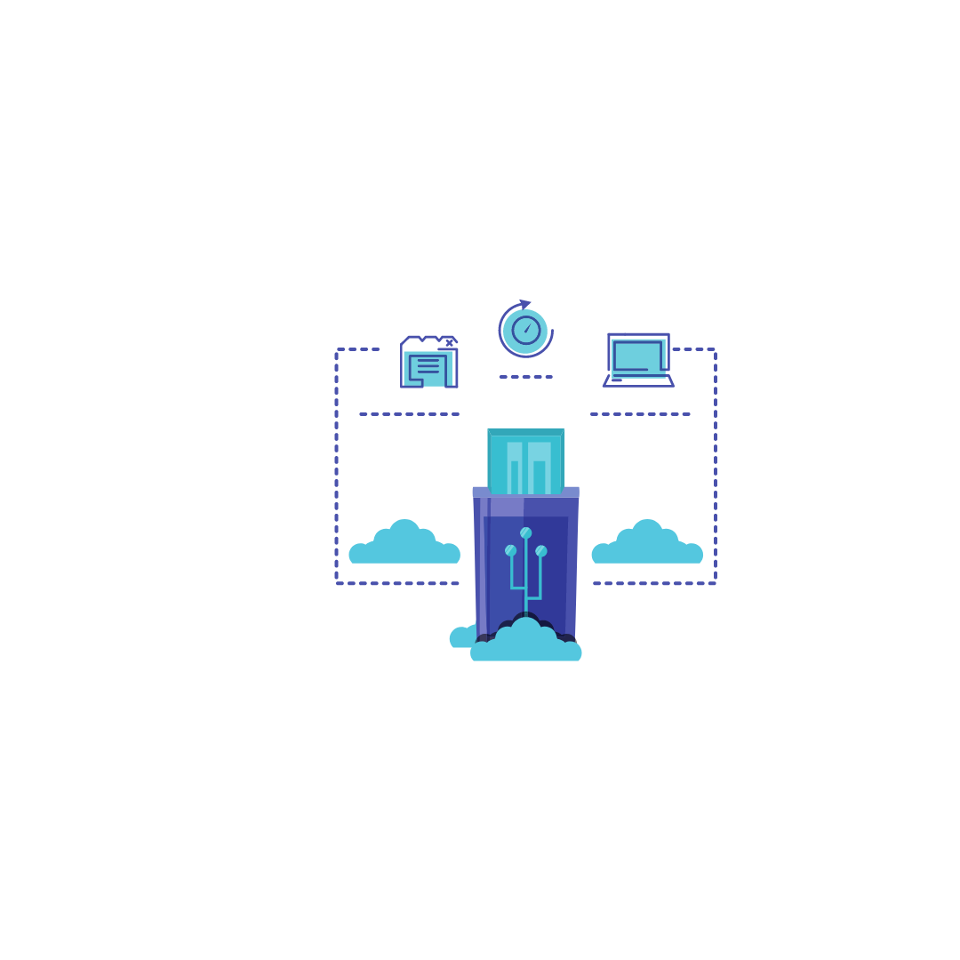

3 key building blocks to bring this to life in any country
Governance
Tech Standards
Market
Regulatory Directive(s)
Independent Consent Managers
Ecosystem Operating Entity
Market Expansion use case
Orchestrate adoption
Reciprocity rule
Consent standard
Data sharing APIs
Sector Info schema
(Financial)

Slide 16
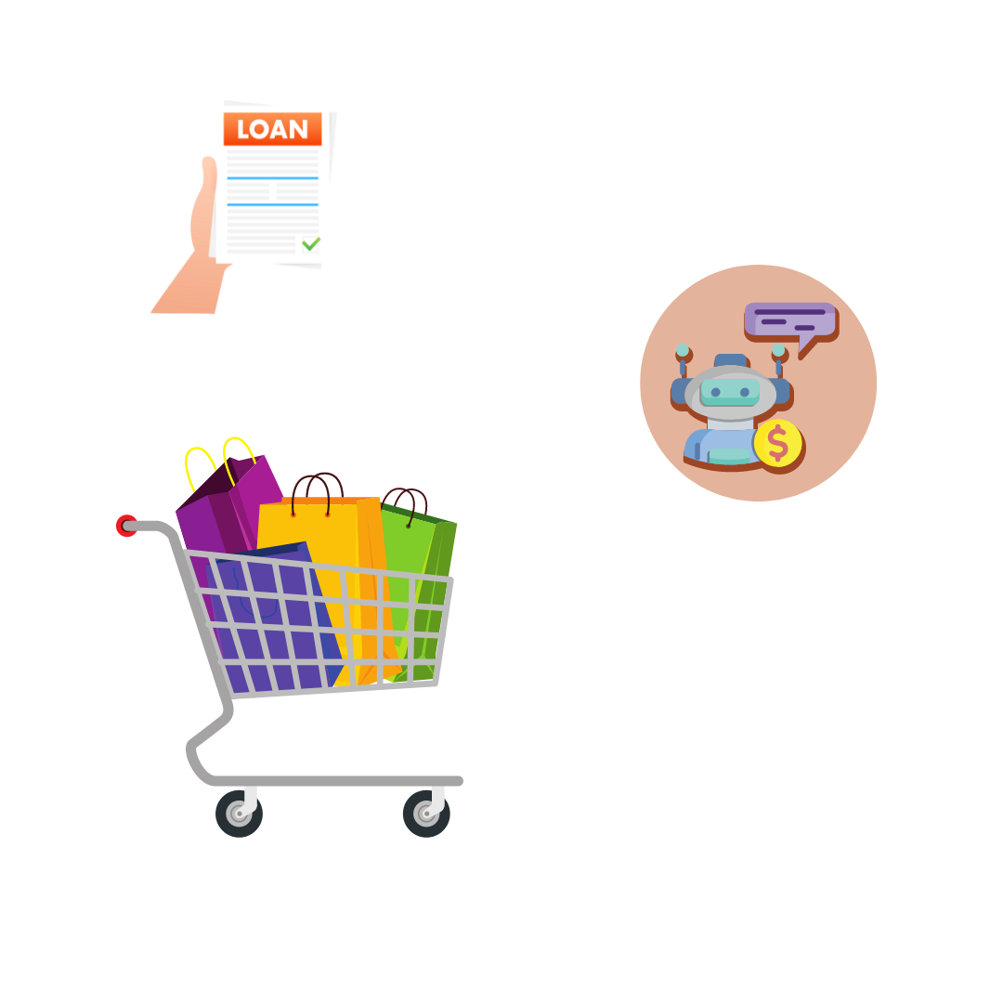
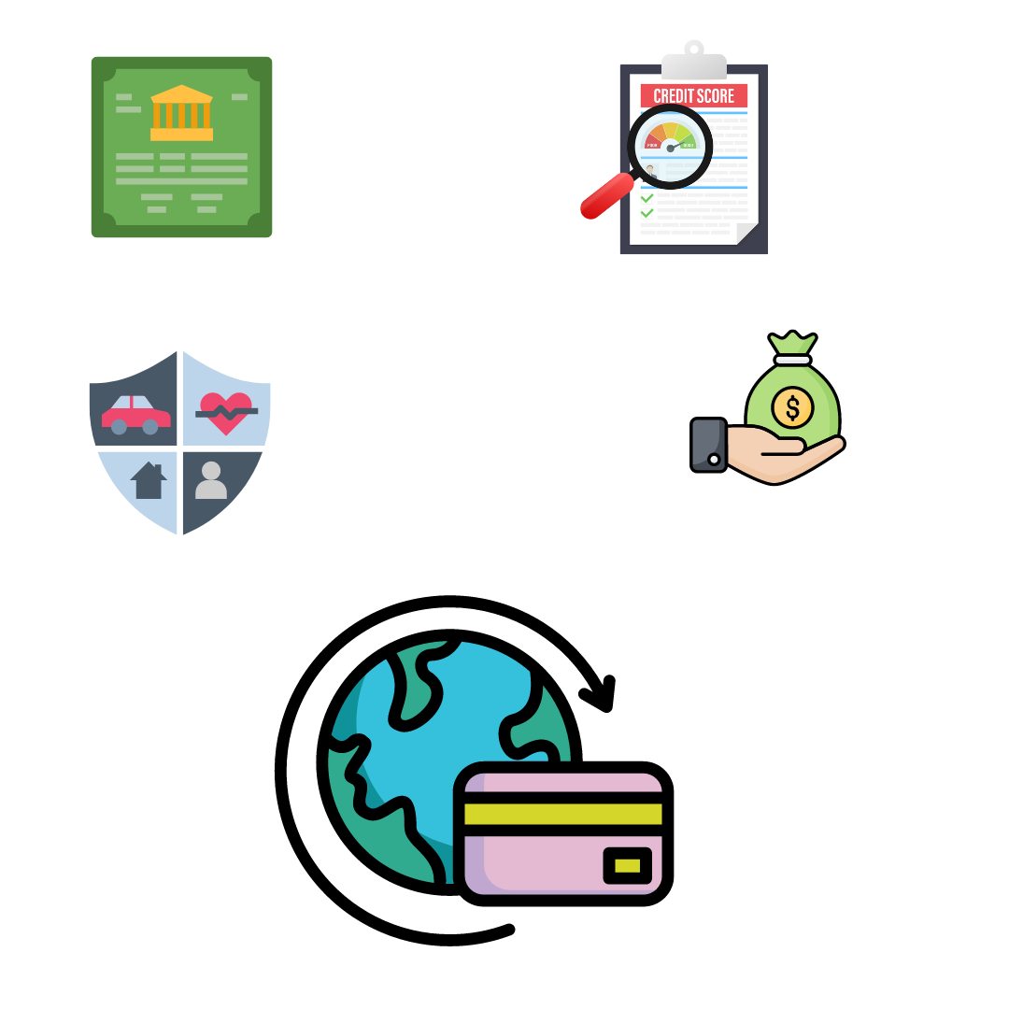

Open Finance supports financial growth, financial protection and market innovation on credit!
Car, business loans
Insurances
Check out financing
Personal Wealth Management
Wealth advisory
Pension Schemes

Slide 17

India built an ‘Account Aggregator’ network
2.1 Billion live financial accounts
~80 Million API based data
sharing transactions
Brazil’s designed Open Finance framework.
33 Million* API-based data sharing transactions
21 Million customers participating
Numbers as of 13/03/24*

Slide 18

Thank you!
Centre for Digital Public Infrastructure

